Slide 1
BanaTalk
Qwer1234
UMJCS.Jeff.Onion.Tonymao

Slide 2
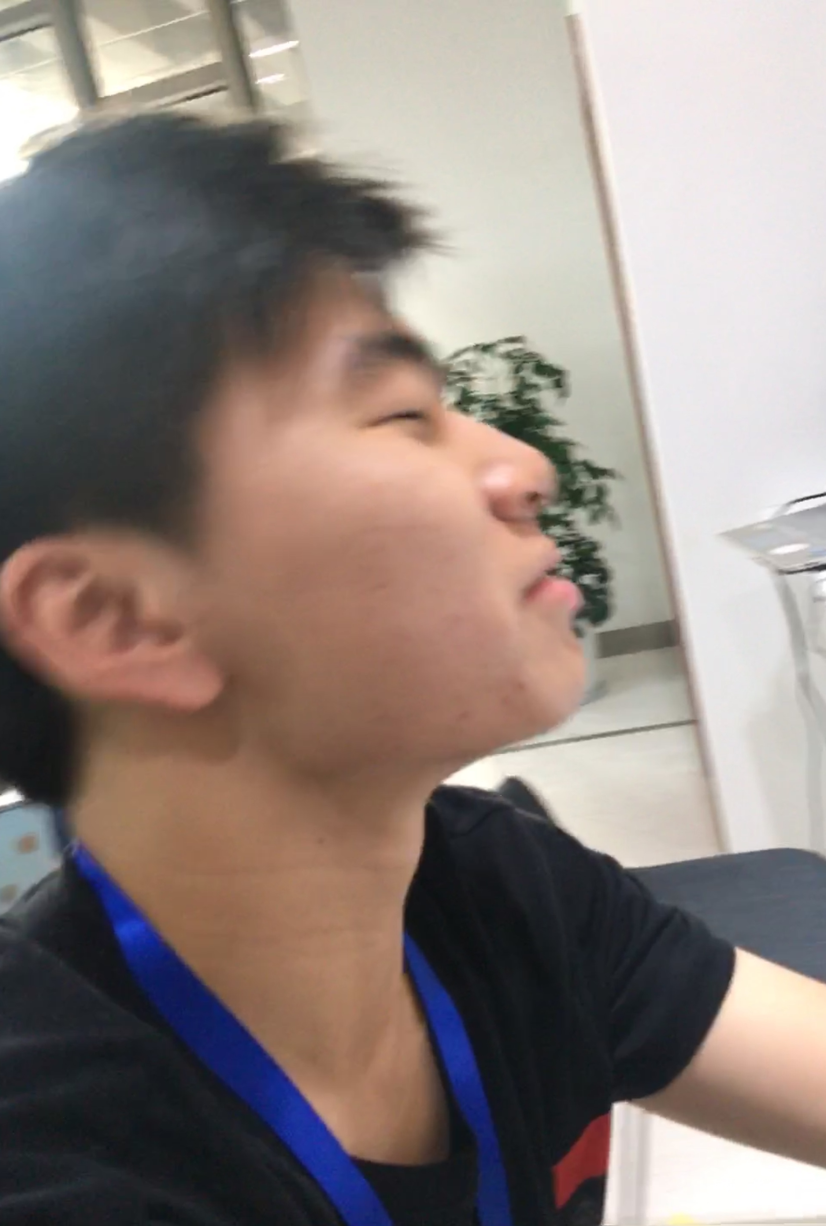
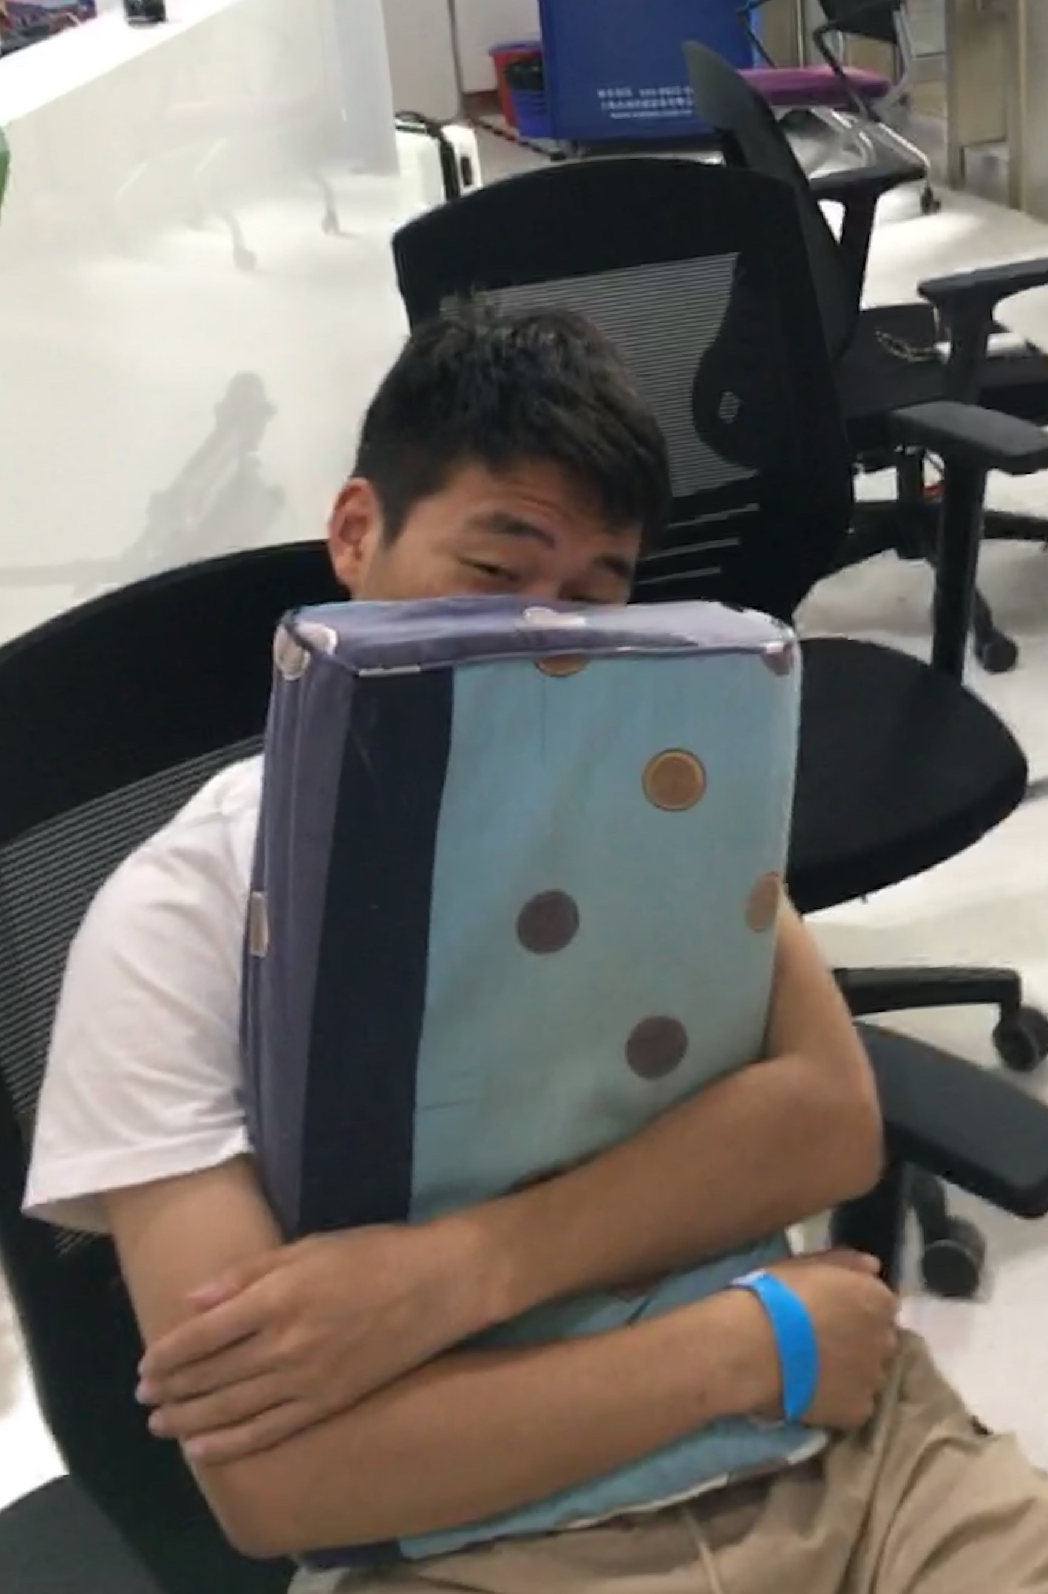
Team members(At 5:00)
4
03
2008
2009
2010
2011
2016
2017
2007
2012
2014
2015
2006
UMJCS
Programmer
Deep learning Implement/Web Spider
Back-end Develop
Jeff Chiang
Programmer
Django/Back-end Develop
Notes:
Photo credit: https://www.flickr.com/photos/tripletsisters/6795243547

Slide 3
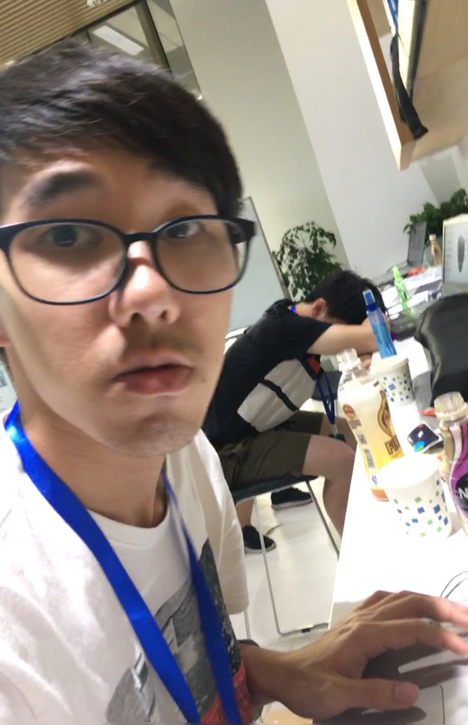
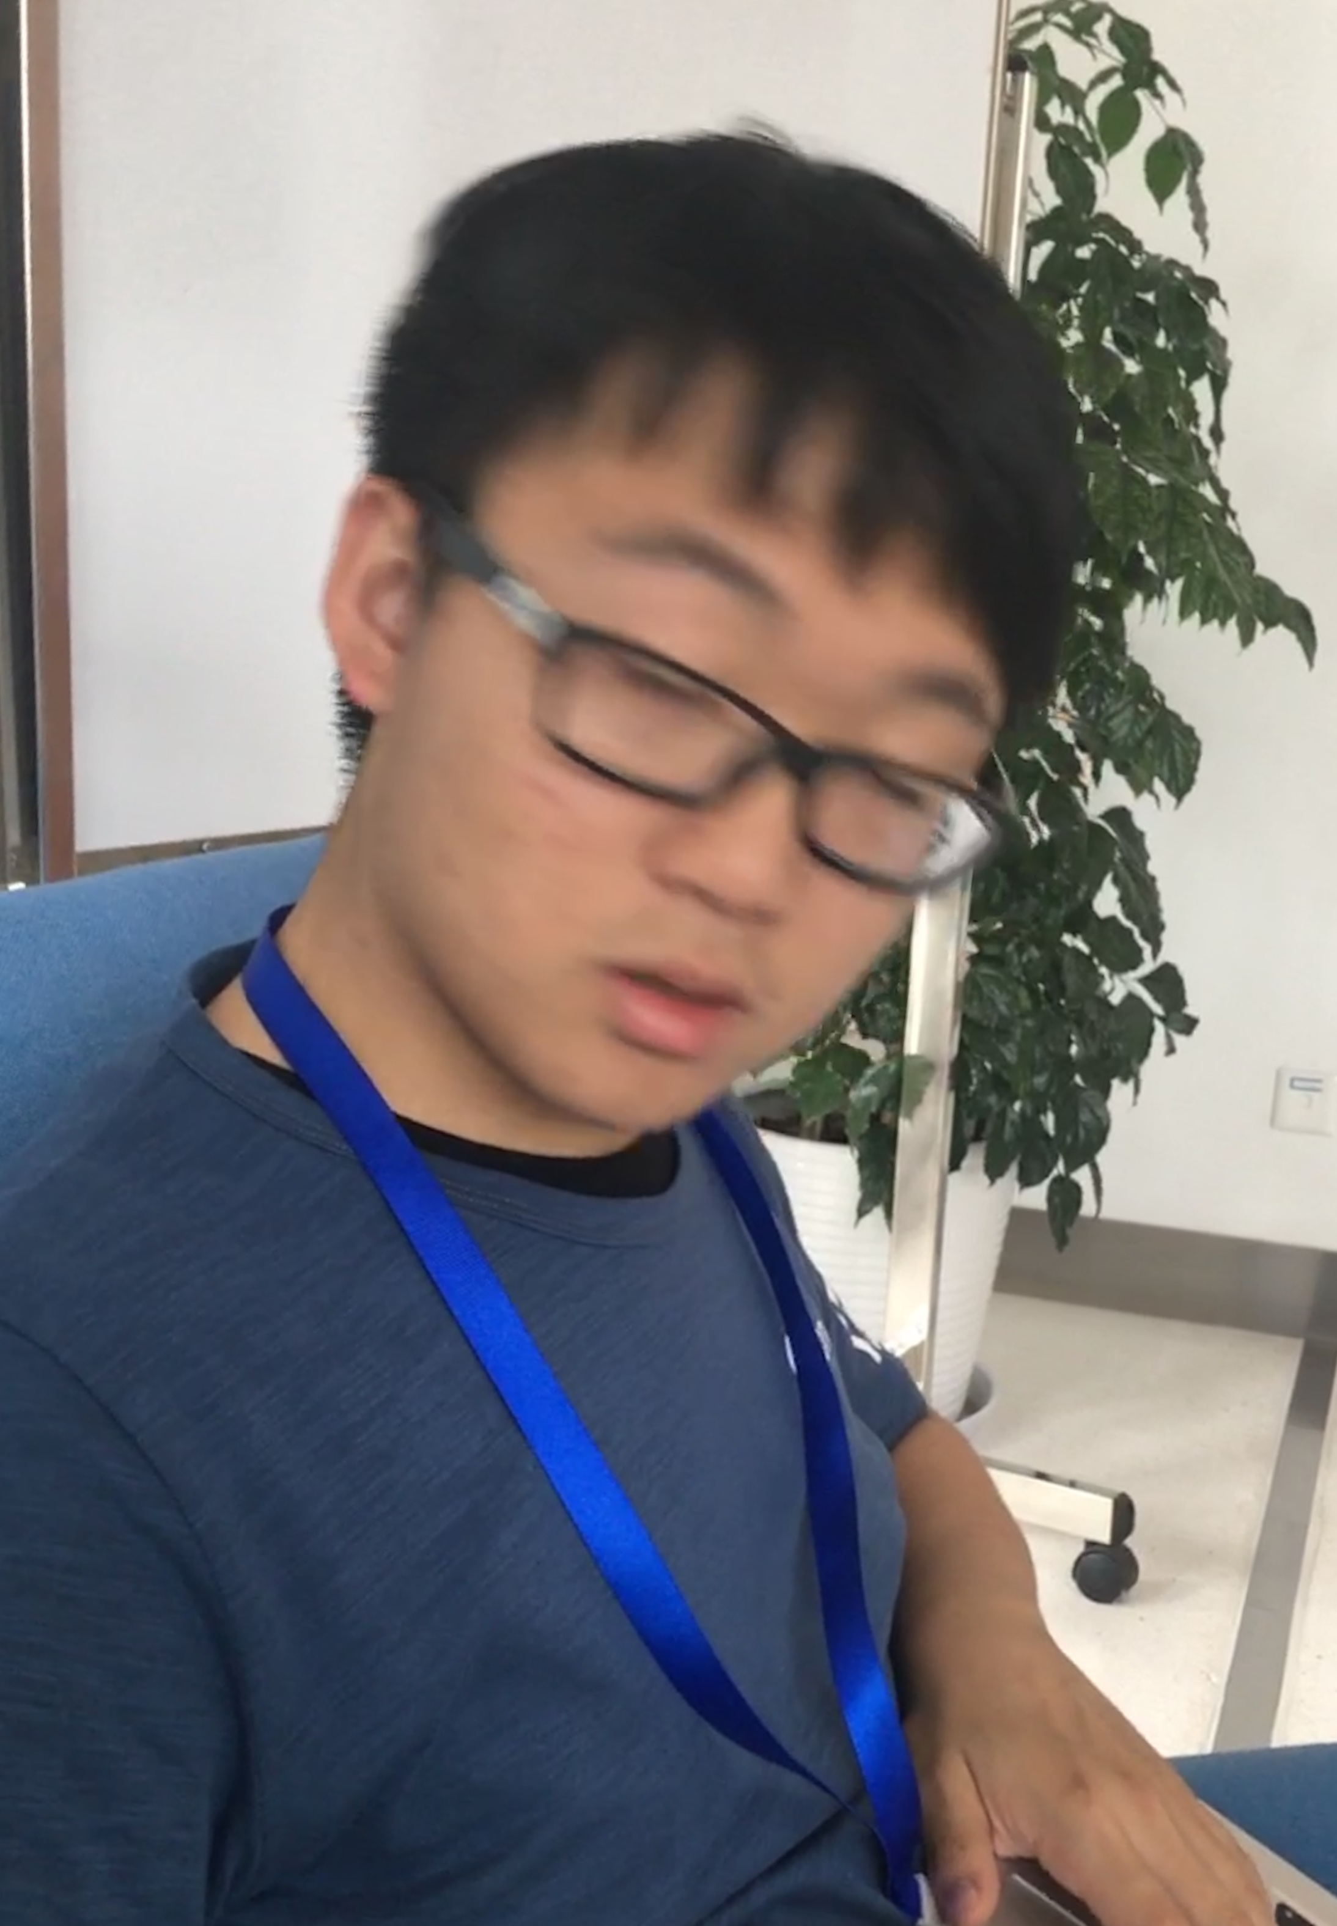
Team members(At 5:00)
4
03
2008
2009
2010
2011
2016
2017
2007
2012
2014
2015
2006
Onion
Programmer
Bootstrap/Front-end Develop
Tony
Programmer
Django / Back-end Develop
Notes:
Photo credit: https://www.flickr.com/photos/tripletsisters/6795243547

Slide 4
Origin Idea
4
03
2008
2009
2010
2011
2016
2017
2007
2012
2014
2015
2006
Originally, We want to use photo detect and render things in photo like human to develop an app for fun.
Later we decide to add something useful to human who need a accurate data of their daily diet,
Notes:
Photo credit: https://www.flickr.com/photos/tripletsisters/6795243547

Slide 5
Framework Layout
4
03
2008
2009
2010
2011
2016
2017
2007
2012
2014
2015
2006
This is a nutrition manager, keep you with a healthy and balanced diet via barcode recognition & photo detection and classification.
This is also a cute food AI, It can bear your diet in mind and give you advices of your daily diet through chatting with you.
Notes:
Photo credit: https://www.flickr.com/photos/tripletsisters/6795243547

Slide 6
Framework Layout
4
03
2008
2009
2010
2011
2016
2017
2007
2012
2014
2015
2006
We classify your food photo using Deep Learning technique and implement with the help of CNN and custom vision. And we will let each food know how much nutrition you have fetched.
Finally render to the website and mobile devices with Django and Bootstrap, implement the online chatting and daily tracking AI talk just like us human, to give advices based on the dataset.
Notes:
Photo credit: https://www.flickr.com/photos/tripletsisters/6795243547

Slide 7
Framework in Detail
输入端
CNN/LeCNN Deep Learning Model to Classification Photo item
Multi-platform photo classification
Details
Implement

Slide 8
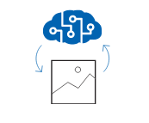
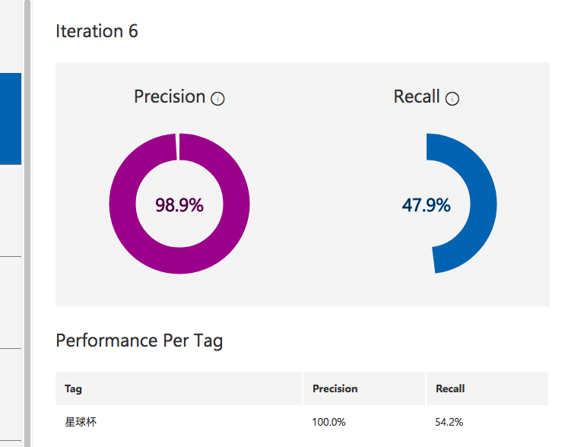
Framework in Detail
CNN MODEL
with Random Forest
to Classification
Tensorflow
Details
CustomVision

Slide 9
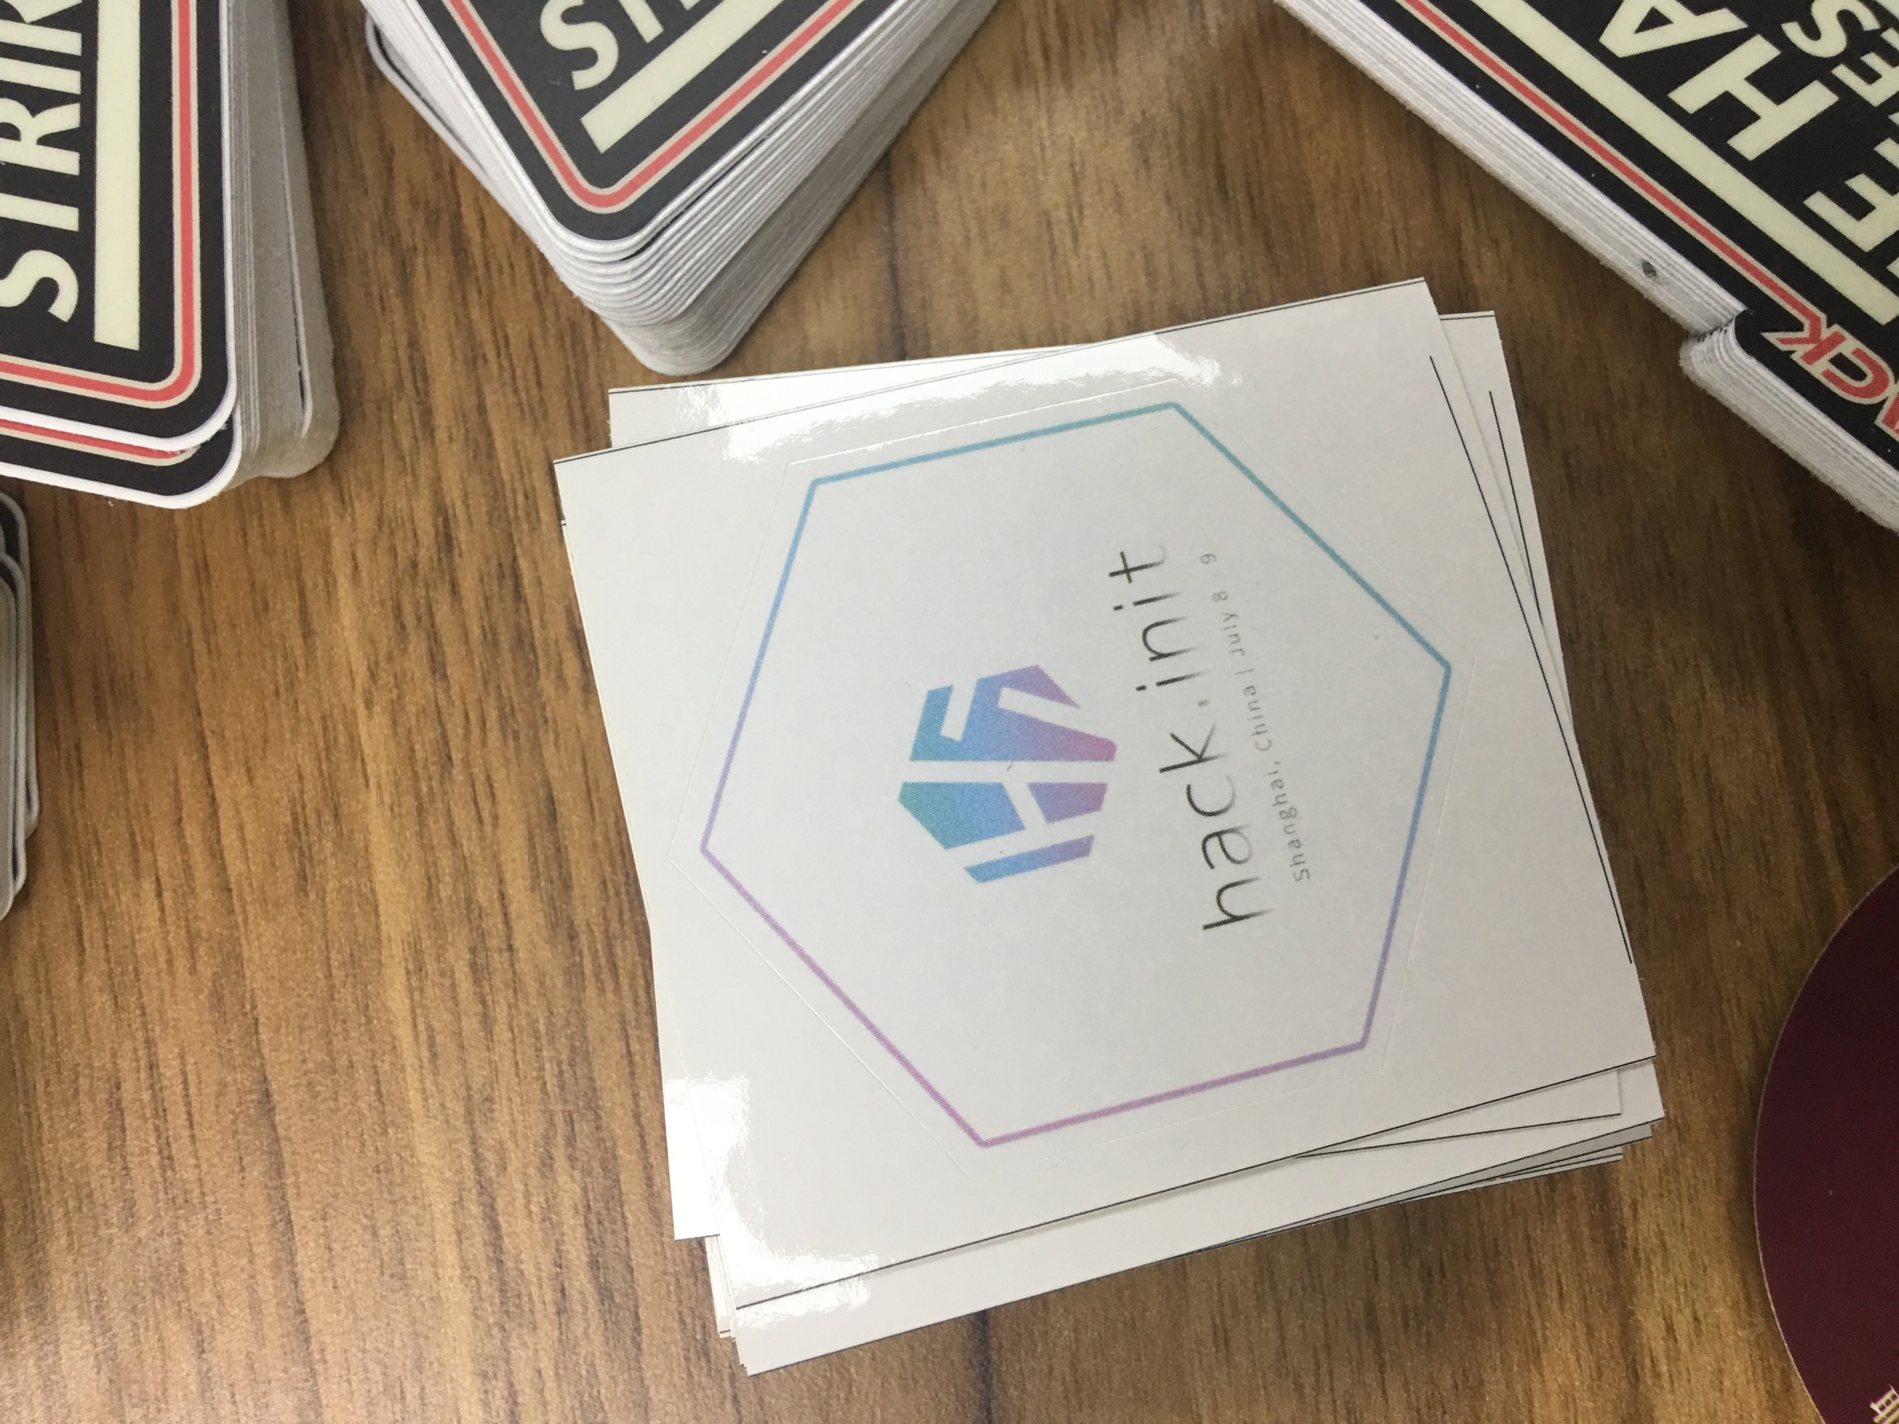
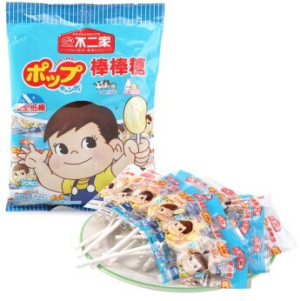
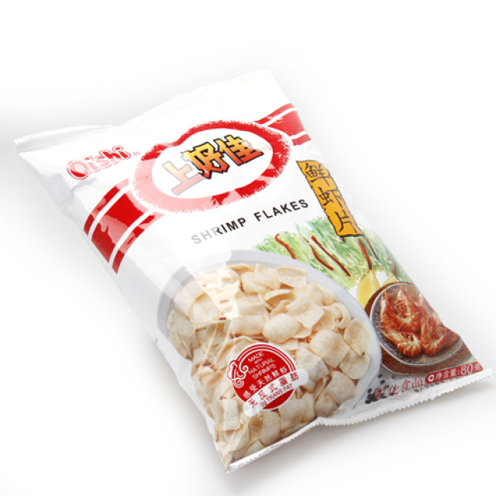
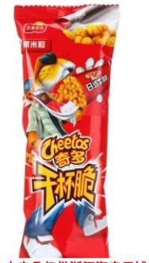
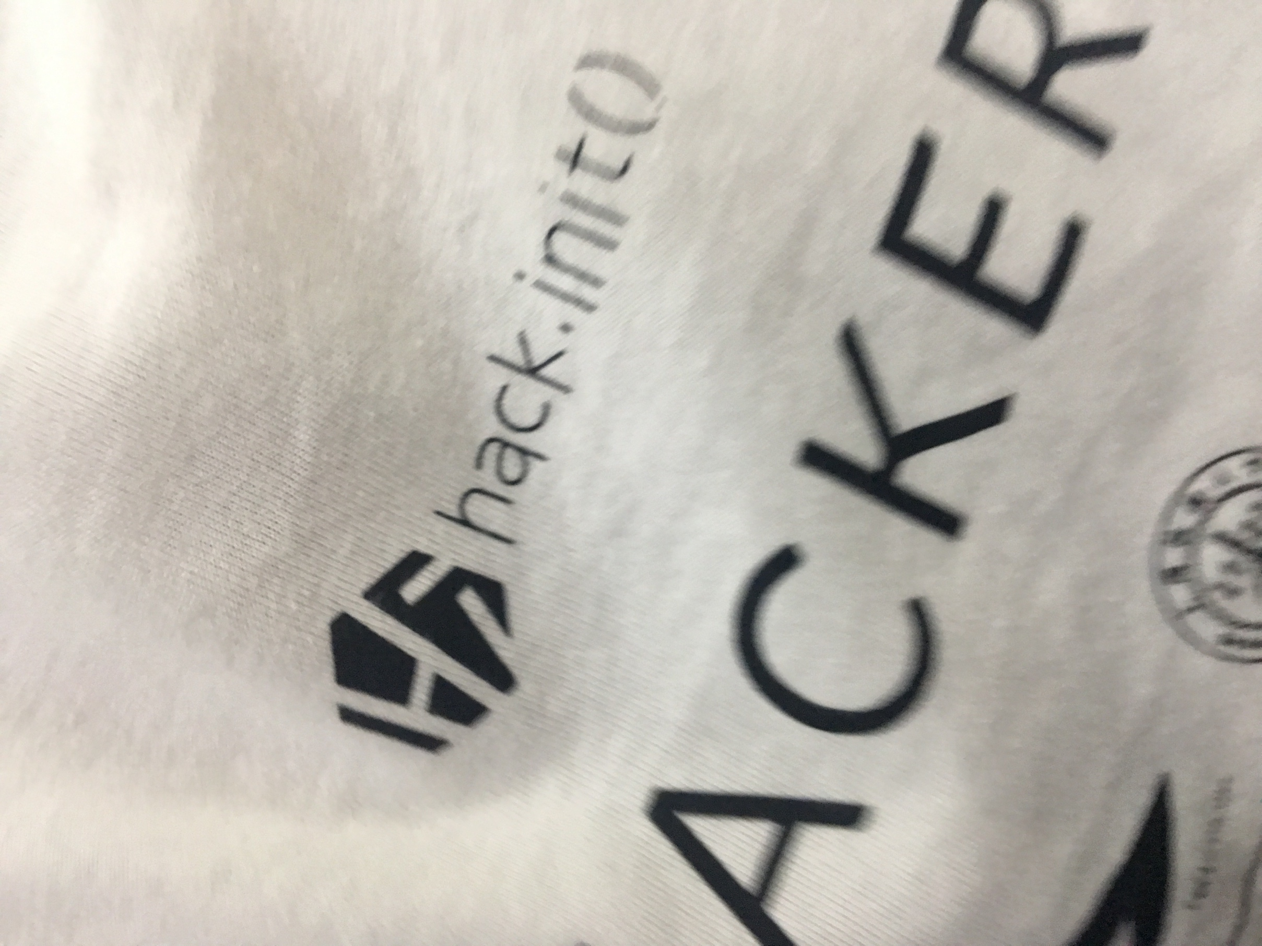
Framework in Detail
CustomVision
We didn’t use the database existed. Instead, we spider photos of things and snacks prepared by hack.init from website randomly.
We also have some photos taken with our cell phones.
You can see that the photos are not that high-quality and Pre-treated
But it will not influent the prediction rate of our model.

Slide 10
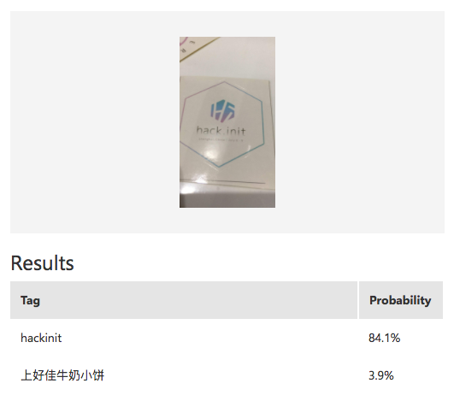
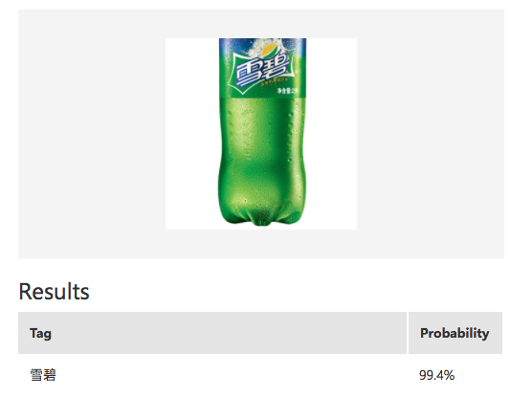
We set up a database of over 1000 image, with several rounds of classifications, the accurate rate can finally be around 95%
Framework in Detail
84.1%
99.4%

Slide 11
Web Development
Hardest…
First we get the prediction from the input image that we try to show the data visually to the web and mobile devices. We want to implement voice contacts between food and users, So we choose Django, Bootstrap as well as NPL tools as our main framework.

Slide 12
Demo Interface && UI

Slide 13
Thank You!
Then Demo Time

